Slide 1
DFAS Open House
MOCAS Overview
Melissa Crawford
Director, Contract Pay Operations
October 16, 2024

Slide 2











What is MOCAS?
WHAT IS MOCAS?
MECHANIZATION
OF
CONTRACT
ADMINISTRATION
SERVICES
Integrated system supporting post-award administration
WHO USES MOCAS?
WHY MOCAS?
Pays More Complex Contracts
  High Dollar
  Multi-Year Contracts
  Multi-Service Contracts
  High Volume Deliverables
  Foreign Currency
  Foreign Military Sales
Pays Financing Payments
  Progress Payments
  Performance-Based Payments
  Commercial Item Financing
  Interim Cost Payments
Integrity - Service - Innovation

Slide 3
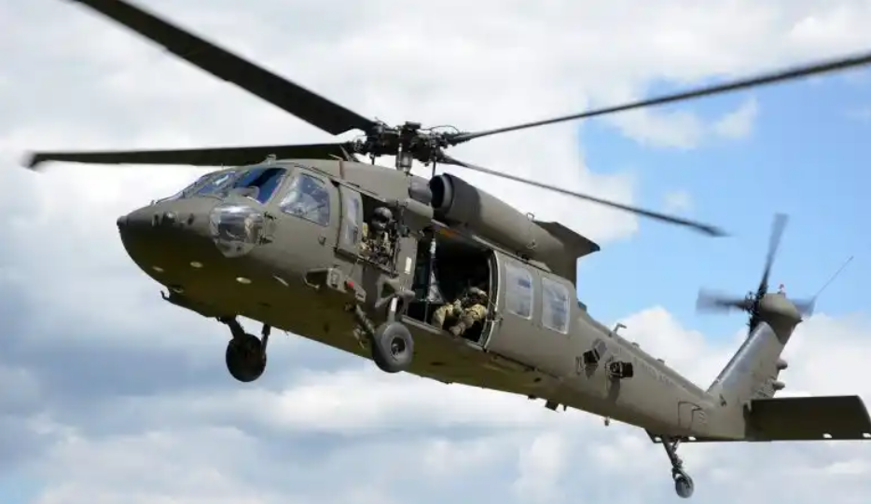
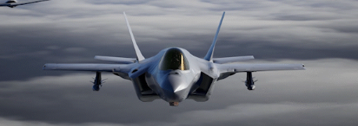
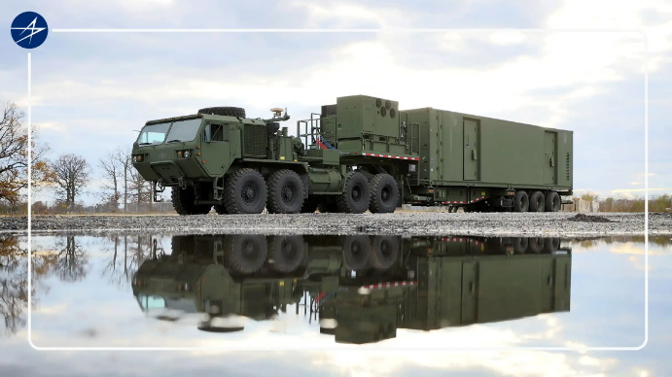
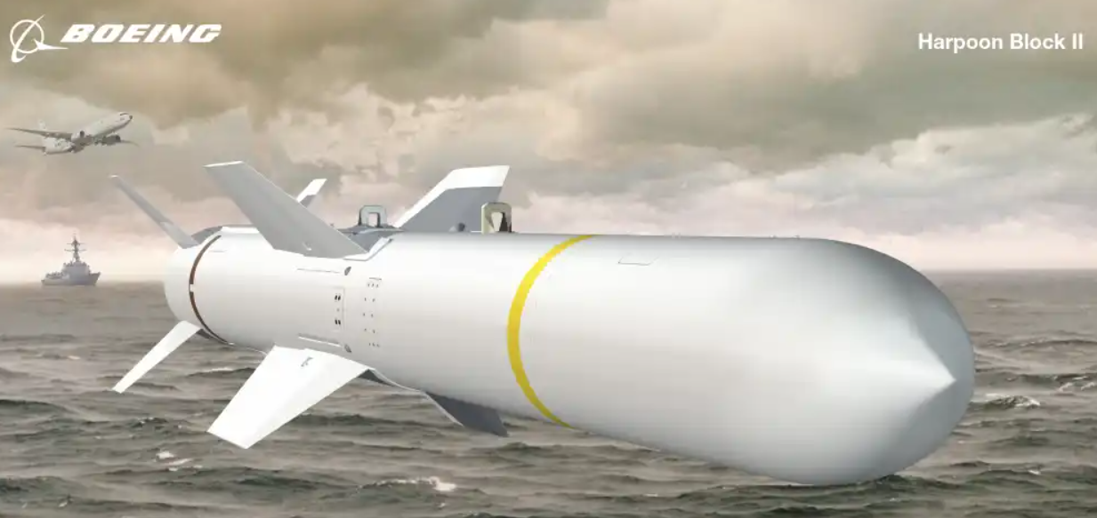
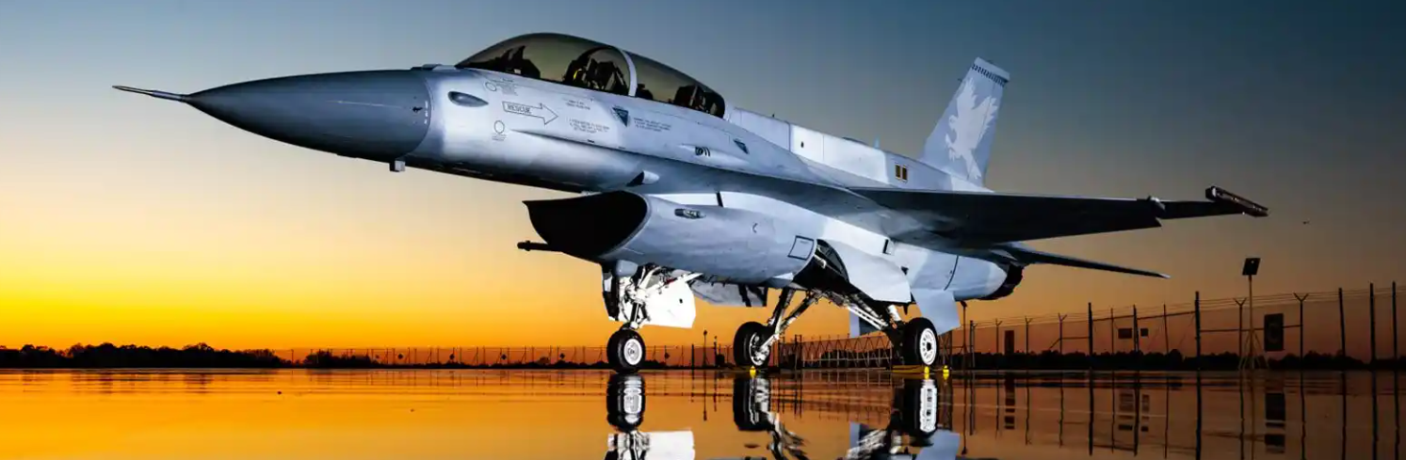
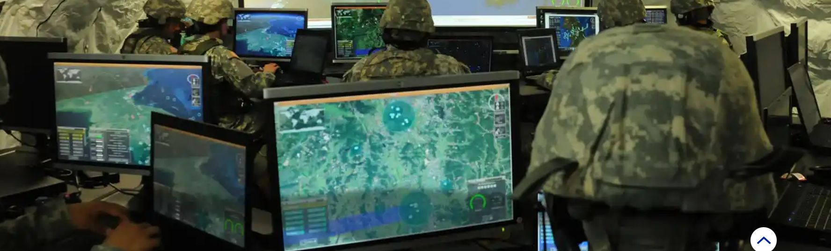
Our Impact
F-117 Nighthawk
Blackhawk
Sikorsky Black Hawk Helicopter
Typhoon Weapon System
F-16

Slide 4
MOCAS Magnitude of Operations
Total Active Contracts – FY 24
Contract Pay – FYE 2023
  287,748 Active Contracts
  17,259 Active Contractors
  $2.77 Trillion Obligations
  653,252 Invoices Processed
  $222.34 Billion Disbursed
Contract Pay – FYTD 2024
  297,896 Active Contracts
  17,270 Active Contractors
  $2.91 Trillion Obligations
  642,806 Invoices Processed
  $225.07 Billion Disbursed
Obligation Dollars by Service
FY 24

Slide 5



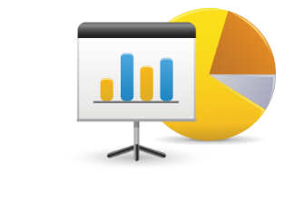
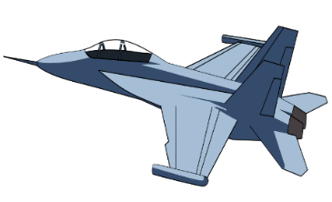
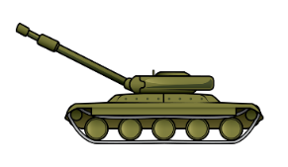




High-Level MOCAS Processing
Contract Writing System
Wide Area Work Flow
Accounting Systems
Contractor Community
EUD System
Federal Reserve
Contracts/
Mods
Invoices/ Receiving Reports
Contract Input
Entitlement
Prevalidation
Disbursing
MOCAS
Reconciliation
SCRT System
1081/
1017G
Integrity - Service - Innovation

Slide 6
Questions?
Integrity - Service - Innovation

